Slide 1


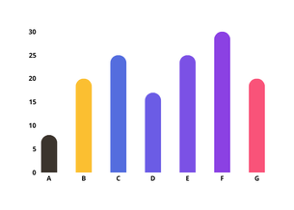




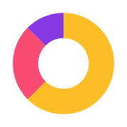




Equity
55%
Annual Revenue
from last month
$12M
Current YTD (Q3)
Growth Strategy Presentation
72%
Today's Expenses
Invalid
$250K
$150K
Total Income
$345M
$100K
Created By : AKIB AHMED
Loan Approval Rate
55%
55%
>65%
55%

Slide 2




Executive Summary
Objective
Core Problem
The Solution
Capture a projected 10% revenue recovery by fixing high-value friction points in the conversion funnel.
80% of our revenue leakage is concentrated in high-AOV categories (Books & Electronics) despite high user intent.
A data-backed roadmap focused on removing UI friction and leveraging social proof to anchor high-value traffic.

Slide 3


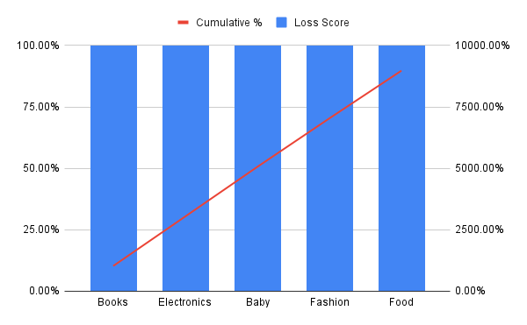
Revenue Concentration (Pareto Analysis)
Revenue Opportunity Gap
Pareto Opportunity Analysis (The 80/20 Rule)
442,626
on target
Current Baseline Efficiency
2.1% CVR
@ 910.67 AOV
Forecast Revenue Recovery
44,263
Expected Growth

Slide 4



60-Day Strategic Roadmap
Phase | Item | Type | ICE Score
Days 1-20 | Frictionless Checkout | UX Fix | 9.3
Days 1-20 | Social Proof Anchor | Copy Test | 8.8
Days 21-45 | Benefit-Driven UI | UX Fix | 8.0
Days 21-45 | Exit-Intent Recovery | Experiment | 7.3
Days 46-60 | High-Value Bundles | Experiment | 6.8
Days 46-60 | Retention Loop | Experiment | 6.2

Slide 5

2 UX Improvements
Cognitive Load
Frictionless Checkout
Top 3 Value Based Specs
Single-Click Guest Checkout
Balanced diversification delivered consistent returns above benchmarks.

Slide 6



1 Copy Test
The Problem: High-AOV products (like your $910.67 baseline) trigger "Buyer’s Remorse" or fear of making a wrong choice. A generic headline like "Explore the History of Humankind" does nothing to lower that fear.
Hypothesis: By replacing a generic product description with a headline driven by Authority Bias and Social Proof, we will reduce the "Trust Gap" and increase the Click-Through Rate (CTR) to the checkout.

Slide 7

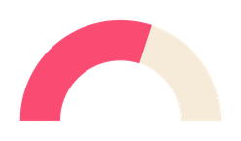



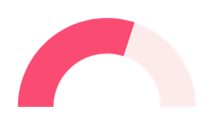



Growth Experiments
Total Opportunity Gap
60-Day Recovery Milestone
Community investments
Gap
Target
Target
442,626
10%
$500K
of total
annual
Current Q3
Forecast Q4
YTD Status
2.1% CVR
10% Recovery
$410K

Slide 8


Thank You

